Slide 1


ICS344: SECURITY COURSE PROJECT
DVSA Vulnerability Investigation
A comprehensive analysis covering all 10 security flaws in the AWS-based Damn Vulnerable Serverless Application.
Team 30
Saud Maashi | Faisal AlSulami | Husam Maslmani | Naif AlFareed

Slide 2
The 10 Serverless Lessons
A structured breakdown of API Gateway, Lambda, DynamoDB, and S3 vulnerabilities—from root cause to remediation.

Slide 3

Lesson 1 & 9: Event Injection
The backend processed untrusted data using unsafe deserialization combined with a vulnerable dependency (`node-serialize`).
The Exploit: We sent a crafted JavaScript payload through the API Gateway. The system treated our input as code, granting us execution to read internal lambda files.
Replaced the unsafe deserialization commands with strict, safe data parsing (`JSON.parse()`), ensuring event headers and bodies remain plain data.

Slide 4

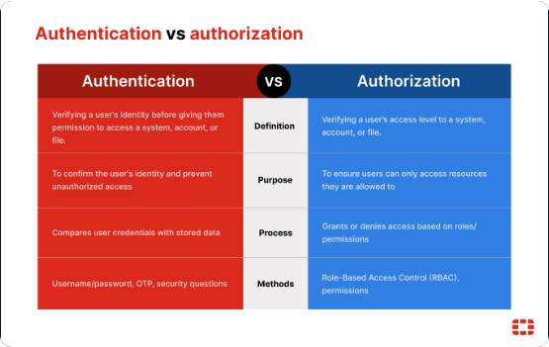
Lesson 2: Broken Authentication
The application used JWT tokens to identify users, but entirely failed to verify the cryptographic signature of these tokens.
The Exploit:
•
We intercepted a valid JWT token.
•
Modified the internal payload (identity) to match a victim.
•
Sent it to the server. The server trusted the fake ID without checking its authenticity, exposing the victim's order history.
Enforced strict JWT signature verification against AWS Cognito keys before processing any user identity claims.

Slide 5


Lesson 3: Info Disclosure
An administrative API incorrectly utilized an unsafe `eval()` function on user-supplied inputs.
The solution required stripping the arbitrary code execution capabilities entirely from the administrative workflow.
We bypassed standard access controls and executed arbitrary code. This allowed us to invoke an internal function that generated and exposed signed S3 download links for private receipts.
We safely parsed incoming requests and enforced strict authorization constraints on the receipt-generation functionality to prevent unauthorized linkage.

Slide 6
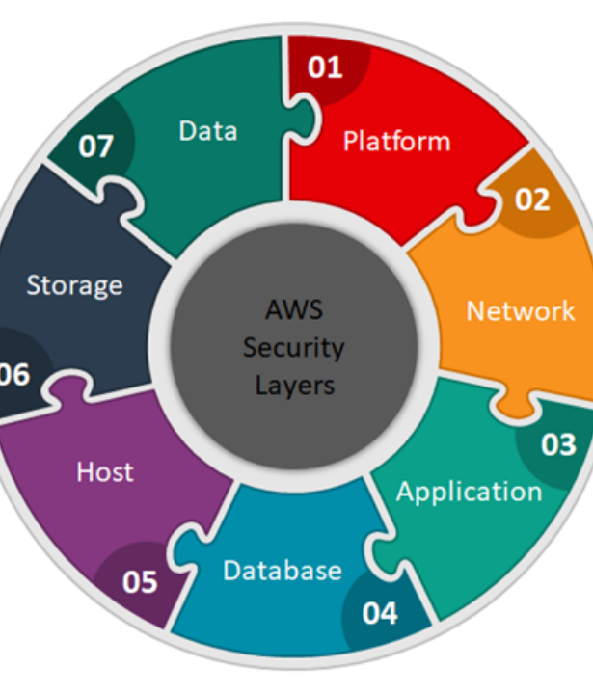
Lesson 4: Insecure Cloud Config
An AWS S3 storage bucket (dvsa-receipts-bucket) was configured with permissive ACLs, exposing a dangerous public write path.
The Exploit: We successfully uploaded attacker-controlled `.raw` files into the trusted date-based receipt paths. The downstream Lambda blindly trusted and processed these files.
We hardened the bucket by turning on "Block Public Access" and removing the overly broad ACL exposures to enforce strict application-only writes.

Slide 7






Lesson 5: Broken Access Control
Missing Guardrails
The Exploit
The Fix
The backend application exposed an "update order" function that lacked proper role-based access control (RBAC). It trusted any logged-in user without verifying administrative privileges.
Operating as a normal, unprivileged user, we accessed this admin-only function and manually changed our own order status from "unpaid" to "paid" without completing the billing process.
Implemented strict role validation to ensure only users with confirmed administrative JWT claims can trigger sensitive system state updates.

Slide 8
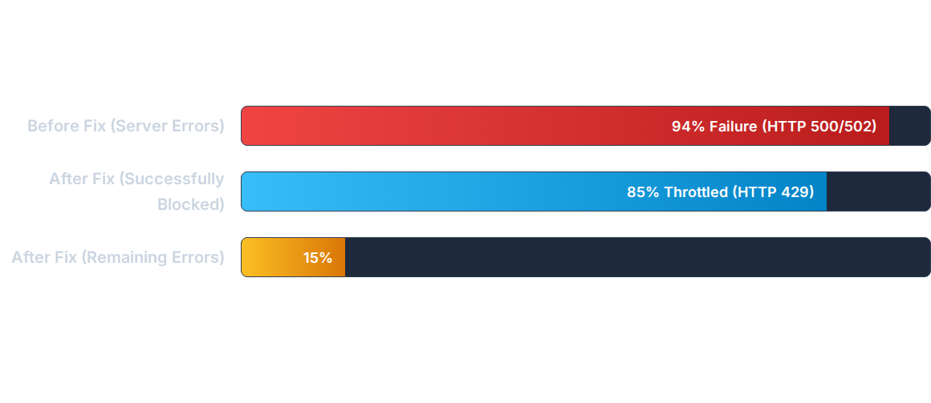
Lesson 6: Denial of Service
The API Gateway lacked rate limiting. Sending massive concurrent requests completely overwhelmed the backend Lambda functions, causing a severe drop in availability.
The Fix: We enabled API Gateway Throttling (Rate: 10 req/s, Burst: 20). The system now proactively blocks abusive traffic before it can exhaust backend resources.

Slide 9


Lesson 7: Over-privileged Func
A receipt-email function was given excessive database permissions (like full table scans) and accidentally logged its own temporary AWS STS credentials into CloudWatch logs.
The Impact: An attacker reading the logs could steal those keys and use them to scan the entire company database, expanding the blast radius massively.
Removed the secret key logging and applied the Principle of Least Privilege to the IAM policy, removing unnecessary DynamoDB Scan/Query actions.

Slide 10


Lesson 8: Logic Vulnerability
The system failed to lock an order once the payment process started, creating a race condition.
We implemented conditional updates and early locking using DynamoDB.
The order status shifts to 200 ("processing") the exact moment payment begins. Subsequent update requests (which require status 100) are instantly rejected.
We sent a "pay" request for 1 item and instantly fired an "update cart" request for 10 items. The overlapping timing confused the server, charging us for 1 item but delivering 10.

Slide 11






Lesson 10: Unhandled Exceptions
The Flaw
The Exploit
The Fix
When bad data caused the system to crash, backend exceptions were returned directly to the client instead of being handled gracefully.
By intentionally sending malformed data (like `bad\r\nhost:evil`), we forced errors that exposed raw stack traces, code snippets, and internal `/var/task/` file paths.
Caught errors globally. We logged the deep technical details internally in CloudWatch, but returned only safe, generic JSON error messages to the end user.

Slide 12
Key Security Takeaways
Defense in Depth: Security cannot exist in code alone. You must secure the entire serverless pipeline: API Gateway limits, IAM role permissions, and S3 storage settings.
Principle of Least Privilege: Never give a Lambda function more access than it strictly requires. If breached, a function's IAM permissions define the attack's blast radius.
Never Trust User Input: Whether it's a JWT identity claim, an uploaded file name, or a checkout race condition—validate everything strictly on the server side.
Fail Securely: Applications will inevitably encounter errors. Ensure that crashes fail closed and never leak internal blueprints or stack traces to the public.

Slide 13
Questions?
Thank you for your time and attention.
KFUPM | ICS344 Information Security | Team 30

Slide 14




Image Sources
https://image-optimizer.cyberriskalliance.com/unsafe/1920x0/https://files.cyberriskalliance.com/wp-content/uploads/2024/02/020924_cyberattack.jpg
Source: www.scworld.com
https://www.fortinet.com/content/dam/fortinet/images/cyberglossary/authentication-vs-authorization-one-.jpg
Source: www.fortinet.com
https://www.1cloudhub.com/wp-content/uploads/2023/06/Picture1.png
Source: www.1cloudhub.com
https://cruciallogics.com/wp-content/uploads/2025/04/Privileged-Identity-Management-How-to-Enforce-it-With-Microsoft-Entra-2-scaled.jpg
Source: cruciallogics.com

